Slide 1
Questions EPPN Project
21-01-22

Slide 2
Homozygosity
How were the parents made homozygous? By selfing?
Selfing = inbreeding? What is a RIL?
Definition:
Inbreeding is a term in genetics, meaning the crossing (mating) of closely related animals or plants. Self-fertilisation in plants is the most extreme kind of inbreeding. It is quite widespread in plants which carry both male and female flowers on the same plant.[1] Inbreeding is the opposite of outcrossing, which is the mating of unrelated members of the same species. The combination of inbreeding and outcrossing is a standard method of artificial selection.
Other terms are inbred strain, a group of organisms so inbred that they have little or no genetic variation, and inbreeding depression, which is the decreased fitness (usually lack of fertility and early illness and death) brought about by inbreeding.
https://simple.wikipedia.org/wiki/Inbreeding

Slide 3
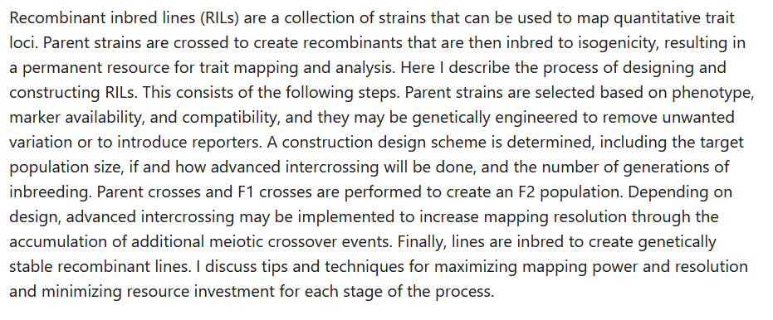
Design and construction of recombinant inbred lines

Slide 4
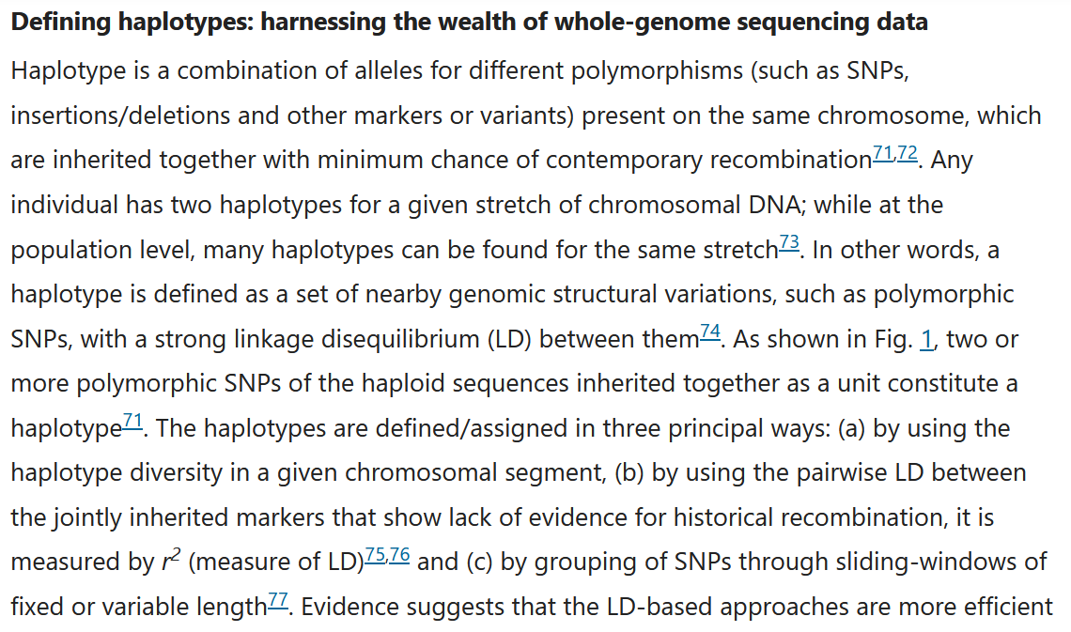
https://www.nature.com/articles/s42003-021-02782-y

Slide 5
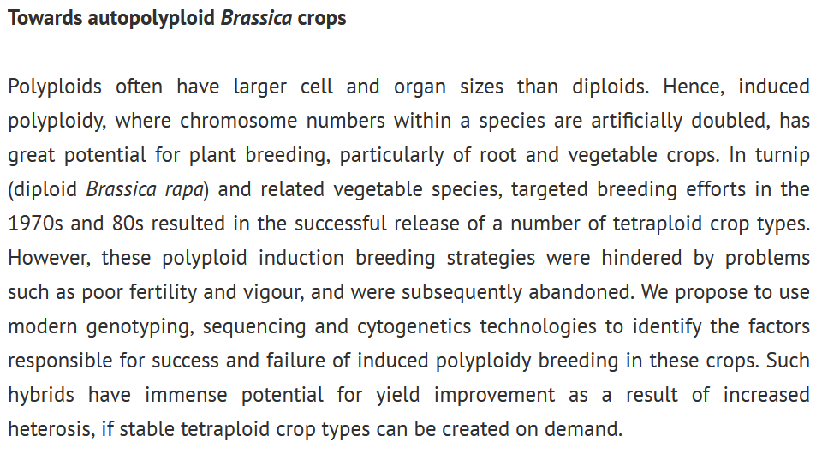
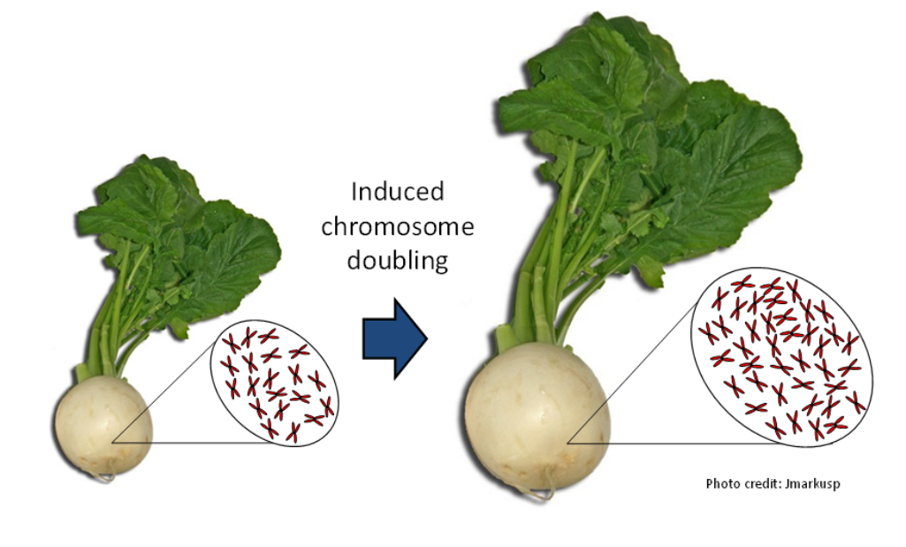
What are the factors responsible for fertility and vigour of induced polyploidy breeding?
Potential for improved yield due to heterosis.

Slide 6
Was man anhand der DNA-Sequenzdaten sonst noch untersuchen könnte
Genetic/genomic analyses ↔ meiosis/fertility: Which genetic/genomic features affect / determine fertility (production of viable germ cells) in the newly formed hybrids?
Attribution of traits to genomes: Is it possible to attribute the incorporated traits (growth and reproductive properties) to the A, B and C genome of the diploid or tetraploid parents?
Role of aneuploidy in hybrid speciation? Tracking chromosome and allele inheritance in different populations of novel interspecific hybrids across generations
What are the mechanism/s of genomic stability in recreated B. napus? => high-throughput marker genotyping, fertility phenotyping and cytogenetics

Slide 7
Fragen zu den Daten
Codes für Genotypen verstehen
Zuordnung von Genotypen zu Gruppen / Was soll verglichen werden?
Codes für Treatments verstehen, checken!

Slide 8
"Sets" of comparisons
Was vergleicht man jeweils? Ploidy level oder heterozygosity?
comparison 1: B. rapa, B. oleracea, synthetic B. napus from known parent genotype combinations
=> AA (diplod, homozygous) + CC (diploid, homozygous) = AACC (tetraploid, homozygous)
comparison 2: B. juncea J1, B. carinata C1 and C2, and the B. juncea x B. carinata tetraploids
=> AABB (tetraploid, 2 genomes, homozygous?) + BBCC (tetraploid, 2 genomes, homozygous?) = BBAC? (tetraploid, 3 genomes, homozygous)
comparison 3: B. oleracea TO1000, B. juncea J3, and their allohexaploid O1J3
=> CC (diploid, homozygous) + AABB (tetraploid, 2 genomes, homozygous?) = AABBCC (hexaploid, 3 genomes, homozygous?)
comparison 4: the 7 allohexaploid lines from B. napus x B. carinata x B. juncea combinations, with their B. napus, B. juncea and B. carinata parents
=> Order of crossing?
a complex set of comparisons: each of the heterozygous hexaploids to their two parent hexaploid lines (and maybe all of them to the species parents, but let's see first how reasonable this is)

Slide 9
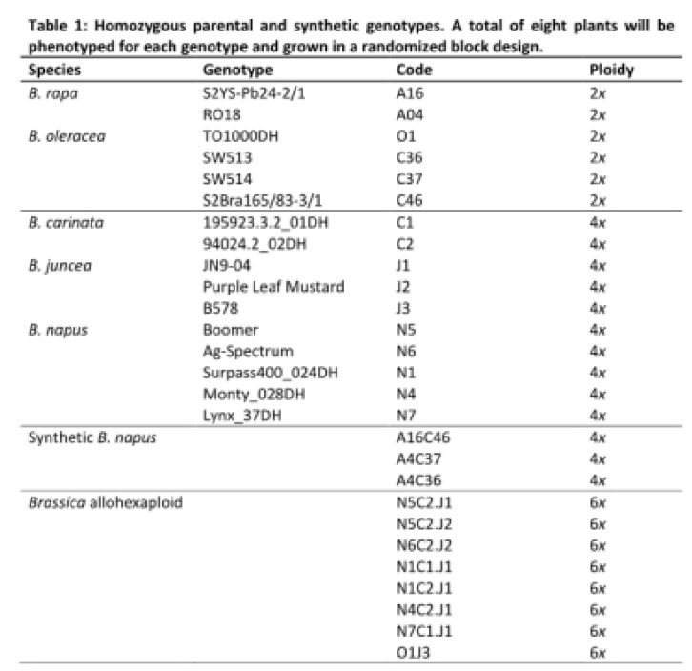
Plant Material
natural species
synthetic

Slide 10
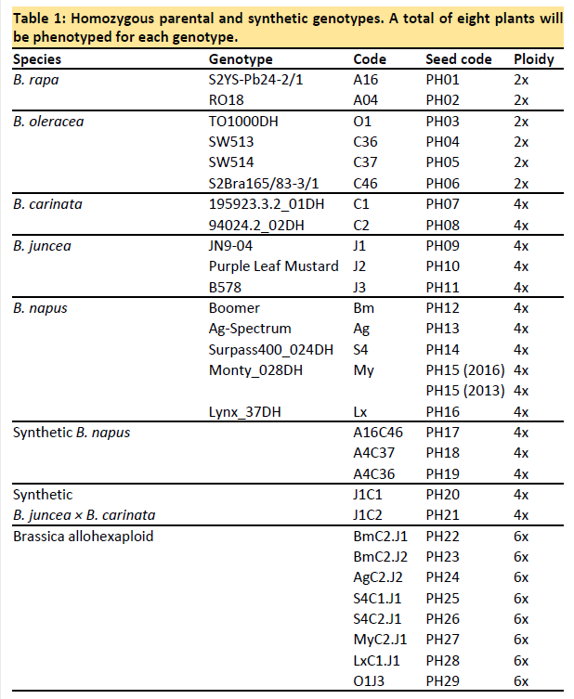

Slide 11
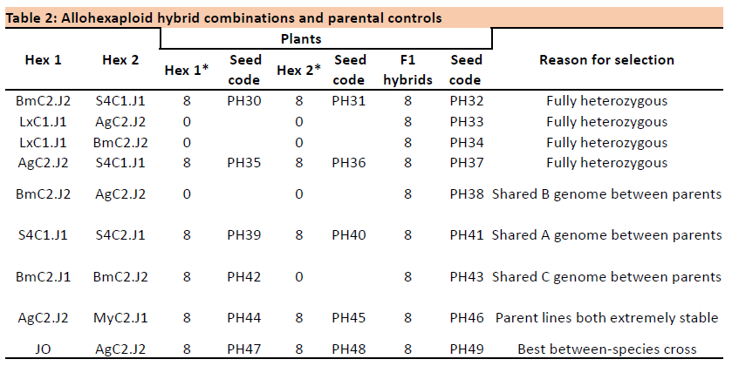

Slide 12
Preparing the data analysis

Slide 13
Heute ganz konkret überlegen, wie Daten ausgewertet werden sollen
1. Vergleichsgruppen: Ploidy Level, Number of genomes and heterozygosity
2. Codes in Data sheet zuordnen, Was ist was? Klappt! Siehe sheet ‚seed codes‘: PH01 – PH49
3. Wachstumdparameter auflisten / Antrag und Data sheet zusammenbringen / Wie sind sie erhoben worden?/Welche werden zusammen ausgewertet?
4. Fertilitätsparameter: s.o.
5. Annalieses Kommentar zur Stabilität: welche genomischen Daten liegen vor?
6. Welche genetischen Daten liegen vor?
7. Hypothesen zuordnen (Antrag)
8. Wie sollen die Parameter ausgewertet werden? Welche statistischen Tests? Welche Grafiken?
9. Antrag: genannte Sequenzdaten nutzen?
10. Story line Paper?

Slide 14
Sets of comparisons: ploidy level, number of genomes and heterozygosity
We want to separate effects of ploidy level and heterozygosity on growth and fertility.
Why not the effects of the number of different genomes? E.g. tetraploids with 2 or 3 genomes.
Why are there no autopolyploids included?
Autopolyploids can be produced from one or two parents, right?
Genomic composition of B. juncea x B. carinata tetraploids: BBAC or different combinations?
comparison 1: B. rapa, B. oleracea, synthetic B. napus from known parent genotype combinations
AA (diplod, homozygous) x CC (diploid, homozygous) = AACC (tetraploid, 2 genomes, homozygous)
Effects of ploidy level and number of genomes (=allopolyploids)
comparison 2: B. juncea J1, B. carinata C1 and C2, and the B. juncea x B. carinata tetraploids
AABB (tetraploid, 2 genomes, homozygous?) x BBCC (tetraploid, 2 genomes, homozygous?) = BBAC? (tetraploid, 3 genomes, homozygous)
Effects of number of genomes. Same ploidy level.
comparison 3: B. oleracea TO1000, B. juncea J3, and their allohexaploid O1J3
CC (diploid, homozygous) x AABB (tetraploid, 2 genomes, homozygous?) = AABBCC (hexaploid, 3 genomes, homozygous?)
Effects of ploidy level (= number of different genomes, in this case)
comparison 4: the 7 allohexaploid lines from B. napus x B. carinata x B. juncea combinations, with their B. napus, B. juncea and B. carinata parents
Order of crossing?
AACC x BBCC x AABB = AABBCC
Effects of ploidy level (= number of different genomes, in this case)
a complex set of comparisons: each of the heterozygous hexaploids to their two parent hexaploid lines (and maybe all of them to the species parents, but let's see first how reasonable this is)
AABBCC (homozygous) x AABBCC (homozygous) = AABBCC (heterozygous)
Effects of heterozygosity. Same ploidy level / number of different genomes.

Slide 15
Summary of questions

Slide 16
Are all parents homozygous, if not otherwise stated? Yes! Varieties like Boomer are homozygous. Exception: B578 is heterozygous. Allohexaploids are also heterozygous, except for hexaploids produced from a tetraploid and a diploid parent (Mwathi, 2020)
We want to separate effects of ploidy level and heterozygosity on growth and fertility.
Do we also have to separate the effects of ploidy level and the number of different genomes? E.g. tetraploids with 2 or 3 genomes. => probably relevant for the proposed advantages of polyploidy (gene redundancy, heterosis, cell size). No, we cannot clearly separate effects of ploidy level and heterozygosity. Think of this as comparing polyploids with their di-/tetraploid parents. See set of comparisons. In BBAC tetraploids the A and C genome behave as one set (see figure in pptx). BBAC can be thought of as having two genomes / two sets of chromosomes. Wenn es in der Genexpression zwischen A und C Probleme gibt, sieht man das an einem stark verringerten Wachstum dieses Individuums.
Why are there no autopolyploids included? Autopolyploids can be produced from one or two parents, right? (=different degrees of heterozygosity) No seeds. Recently creted. Unstable.
Attribution of traits to genomes: Is it possible to attribute the incorporated traits (growth and reproductive properties) to the A, B and C genome of the diploid or tetraploid parents? Attribution theoretically possible for qualitative traits (like resistance in B. nigra or white flower coloure in B. oleracea) but not for quantitative traits such as fertility traits (number of siliques and seeds).
Do I have to know in more detail, how our genotypes were made (original papers)? No! See figure in presentation. Evtl. Mwathi 2020 lesen.
Genomic composition of B. juncea x B. carinata tetraploids: BBAC or different combinations? Different combinations (see Katche, 2019, New Phytol.)
comparison 4: the 7 allohexaploid lines from B. napus x B. carinata x B. juncea combinations => Are they produced from the natural or the synthetic B. napus? I.e. do we have a pyramid in this case? No, they are produced from natural B. napus.
How are parents made homozygous? Inbreeding or microspore culture, which produces double haploid lines. Which is the common one in our work and which in commercial plant breeding?

Slide 17
7. Growth/yield measurements: Are the resulting tetraploids and hexaploids all oil crops? So, none of them are root or head forming vegetables? => Hybrid vigour in terms of larger organs. None of them are root or head forming vegetables, as far as she knows. Some napus are canola, i.e. oil crops. Carinata and juncea are condiment crops. Oleracea is weedy.
8. `Average of branch #´ = branch number/plant or branch length? Probably number. Check for trade-off between seed formation and growth?
9. `Average pod number´ = per plant? Yes! Probably per plant
10. Do the barcodes refer to individual plants? Ask collaborators in meeting
11. Are the fertility parameters assessed here directly related with the stability of meiosis in segregating progeny? No direct relationship, but meiotic instability can cause reduced number of seeds and chromosome losses can lead to growth retardation. Keep bias in mind: Fertility as assessed here as a parameter/indicator of hybrid vigour, but fertility is also affected by meiotic instability in newly formed hybrids.
12. Has the growth rate also been measured manually or by imaging? Probably both, because they wanted to train the imaging system.
13. Randomized block design: How many blocks? Figure of the design? Location 1 and 2? Comp 5 and 6? Ask collaborators in meeting.
14. `Growth rate´, `Total biomass´ in terms of weight and `Time to flowering´ not found in table => assessed by automated phenotyping plattform? Ask collaborators in meeting
15. Genomic and genotyping data mentioned in proposal supposed to be used for further analyses? No specific use, because genes responsible for growth, yield and fertility (=hybrid vigour) of hybrids unknown.

